Slide 1
COMP1004: FINAL PRESENTATION - Typing TESTS
By Max Ferguson

Slide 2
Show FINAL VERSION☺

Slide 3
Project Vision and background.
Why did I make this project?
Personal goal to increase typing speed as much as I can since 2020.
Who it’s for?
Employers and learners
Why?
To test potential hire’s typing speeds and to practice typing
Why is it important?
To improve collaboration between team members within office jobs
To improve efficiency in administers jobs
Databases need accurate data
Multitasking and efficiency
Improved response times to customer
Ethical, legal and social considerations?
Legal – Privacy concerns based on storing their information.
Social – Accessibility concerns based on different input methods

Slide 4
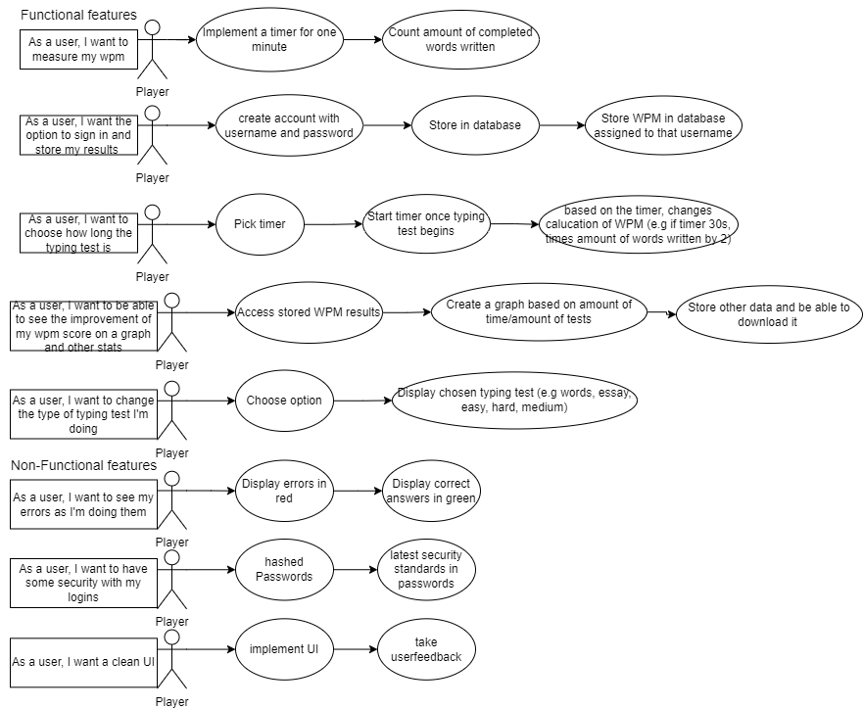
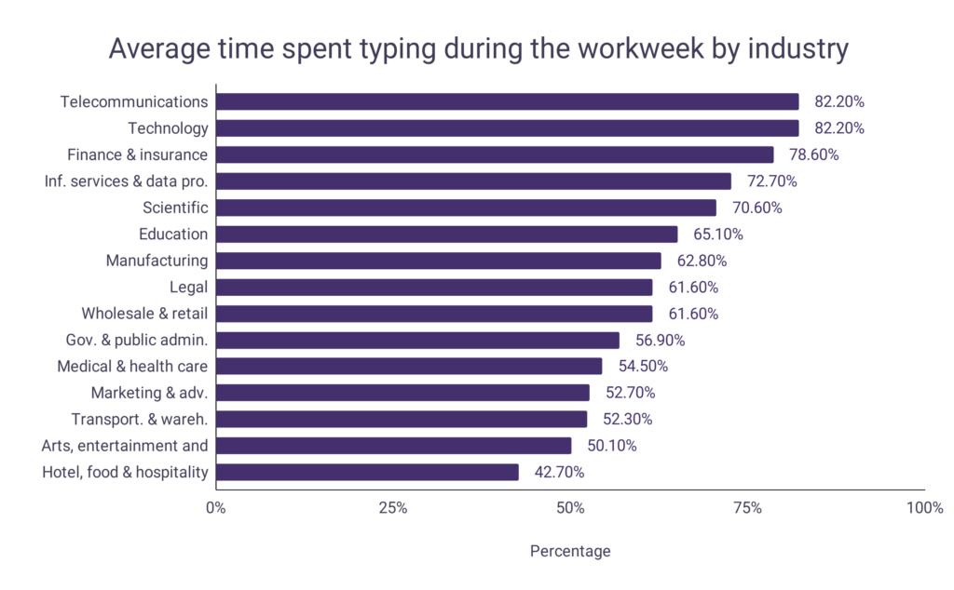


What features did I include to follow my project vision?
Here is my user stories, what intended features I would like to end up with based on my project vision.
There is some statistics showing how often typing skills are used by wordsrated.com

Slide 5
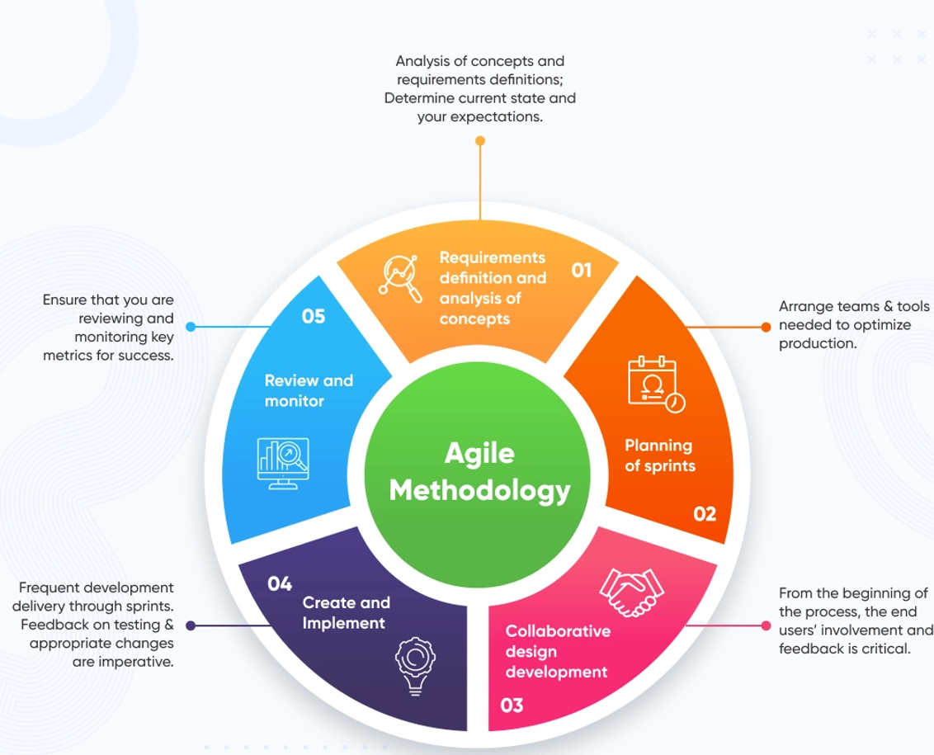
How did I make this project?
I used the recommended agile methodology, specifically the industry standard SCRUM meetings.
In effective, this came with 8 sprints spanning of 16 weeks, with each sprint lasting about 2 weeks.
In each sprint, I had an intended plan for the sprint, building on the previous meeting.
A detailed overview of what my sprints looked like will be shown, such as the backlog for each sprint along aside how far along each user story feature has been implemented across each stage.

Slide 6
SPRINTS
SPRINT 1 (WEEK 1-2) | SPRINT 2 (WEEK 3-4) | SPRINT 3 (WEEK 5–6) | SPRINT 4 (WEEK 7–8) | SPRINT 5 (WEEK 9-10) | SPRINT 6 (WEEK 11-12) | SPRINT 7 (WEEK 13-14) | SPRINT 8 (15-16)
Goals Outline requirements in user stories Create flowchart based on logic Create first wireframes Create ULM Begin learning CSS/JS/HTML | Goals Create skeleton of code Amend ULM/Flowchart when necessary Adhere to wireframe Create working prototype (60 seconds typing test, with wpm returned) | Goals Display WPM + timer on website not console Make correctly inputted words autodeleted on submit Creation of proper testing Randomised input array Implement wireframe Create new ULM | Goals Implementation difficulty options Implementation of timer options Creation of DOM diagram Tell user that typing test is over Display errors live Change WPM calculation Insert comments in JavaScript Attempt word generation | Goals Create new ULM to show new logic Show live WPM Attempt word generation Finish difficulty options Create new wireframe from user feedback Implement endofline function from user feedback Update user stories to include security features Make login system html /wireframe | Goals Allow user to sign in with details stored in a Json Allow user to create a new account and store in Json Allow password to be hidden/shown Allow creation of new user Ensure commenting is well done Creation of wireframe for new pages and implement them Hash passwords Fix paragraphs not deleting properly | Goals Allow wpm to be stored and assigned to user Allow stats to be downloaded as a Json Create wireframe for stats page and implement Replace alerts with nice Ui implementation Allow WPM data to be displayed as graph Retest old features and add new features | Goals Final ULMs create sitemap Create packet diagram Write report Create sequence diagram Ensure class diagram is up to code Add any more QOL if desired Do final testing Delete account button to show CRUD Get user feedback and fix any overlooked errors
Status - Completed sprint - Goals met | Status Completed sprint Goals not met | Status Completed sprint Goals met | Status Completed sprint Goals partially met | Status Completed sprint Goals partially met | Status Completed sprint Goals partially met | Status Completed sprint Goals partially met | Status Completed Sprint Goals mostly met
Next steps Make skeleton of code based on ULM Amend ULM and flowchart where logic changed/flawed Create basic prototype | Next steps Display wpm/timer to website Implement tester Randomised array Implement wireframe Autodelete correct words oninput | Next steps Implementation of difficulty/timer options Letters go red/green if incorrect/correct Create new ULM to show structure Gather user feedback | Next steps Show wpm live Make login system Implement user feedback New ULM to show new logic Implement difficulty options | Next steps Allow log in with data from a Json file Allow a sign up with new data Stop usernames being reused Allow WPM to be stored and assigned to signed in user Allow stats to be show in a graph | Next steps Allow WPM to be stored and assigned to a user Allow stats to be downloaded Replace alerts with nice UI Allow WPM to be displayed as a chart | Next steps Ensure ULMs are up to date Write report Add any QOL features | Next steps - Submission

Slide 7
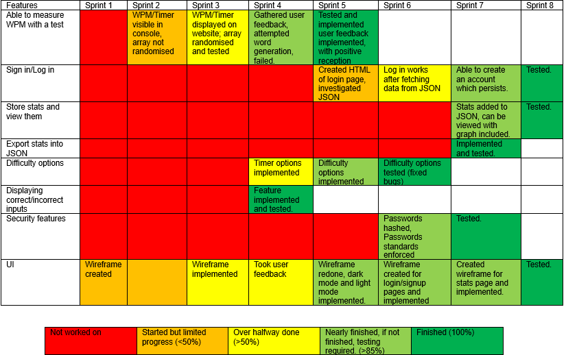
completion USER STORIES COMPARED TO SPRINTS

Slide 8
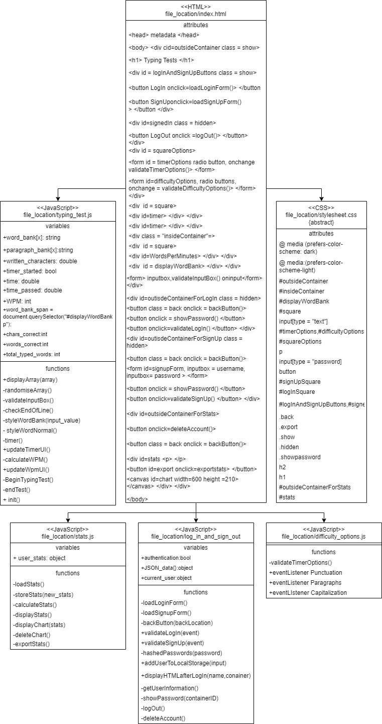
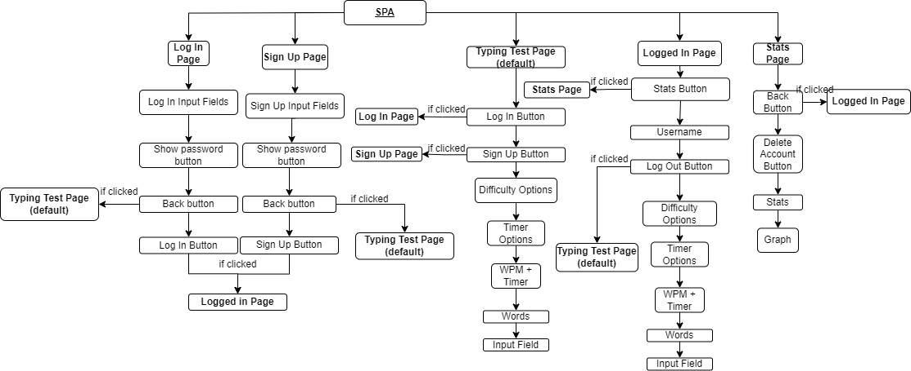
ULM DIAGRAMS
Above is a sitemap, showing both the describing the general layout of the website but also how each page (hidden html
elements) is linked to one another.
To the left is my class diagram showing my HTML,CSS and JavaScript, helping to visualize the structure and implementation of my project.
Next shown are my wireframes, actual implementation is differing slightly, but general layout and coloring is followed.

Slide 9
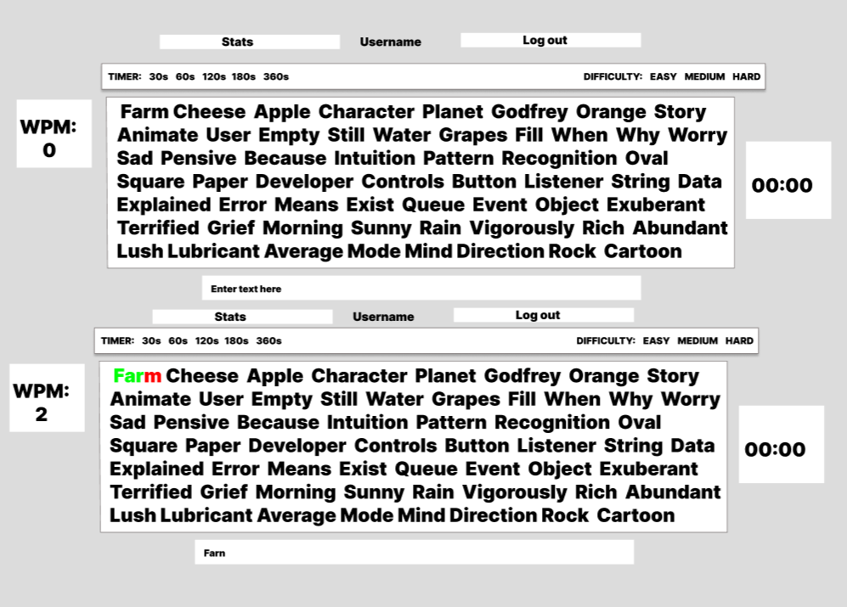
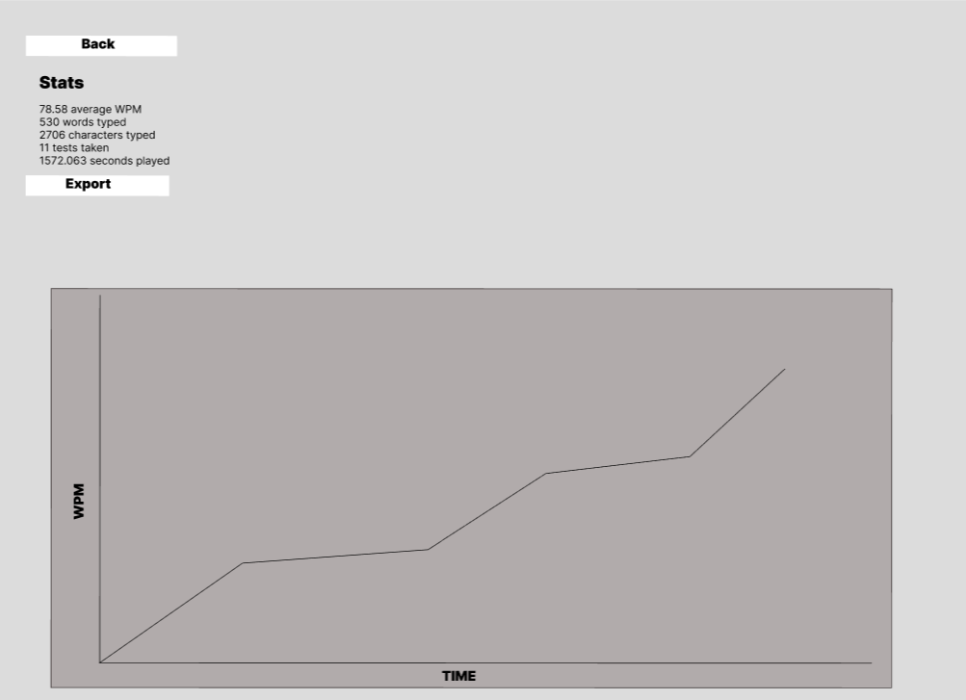
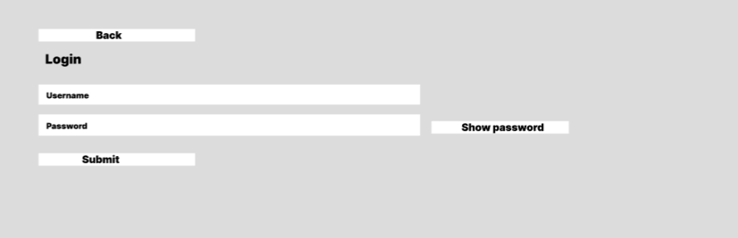
WIREFRAME
Here is what I’d like my website to ideally look like by the end of this project

Slide 10
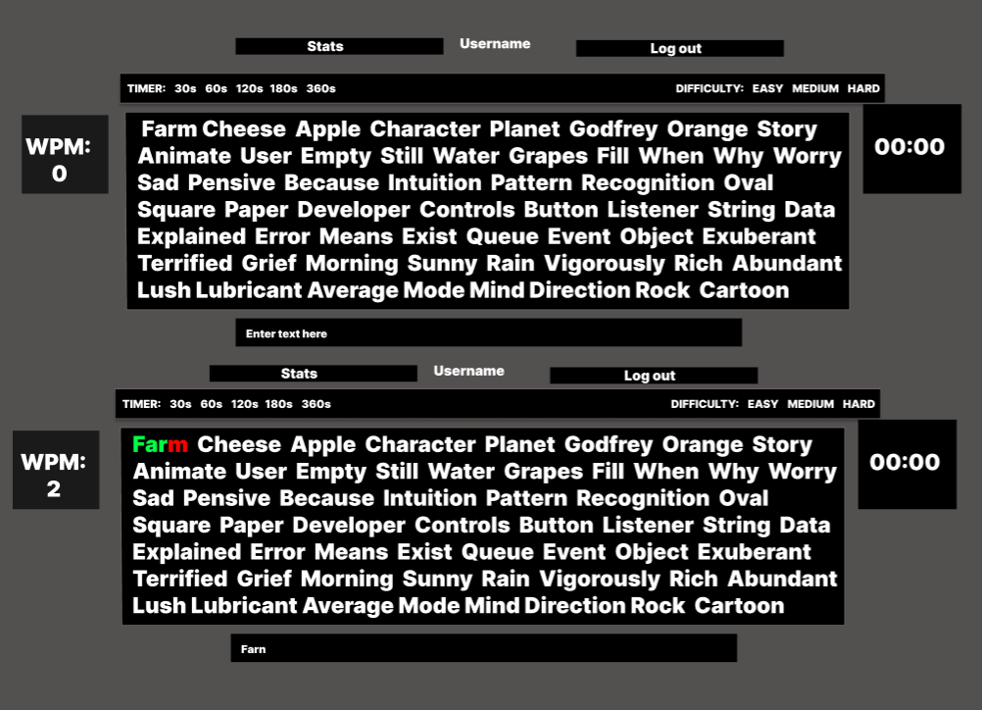
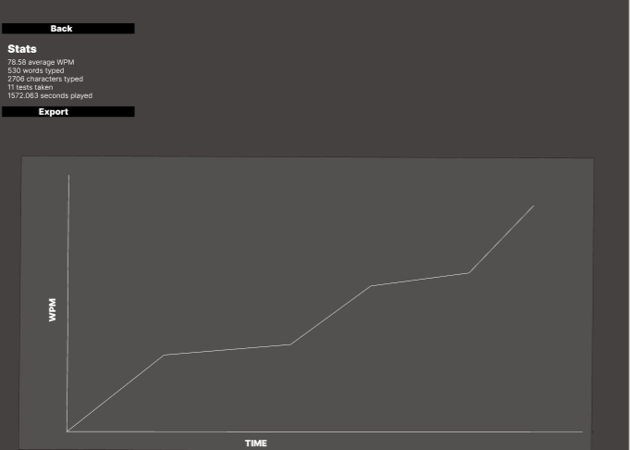
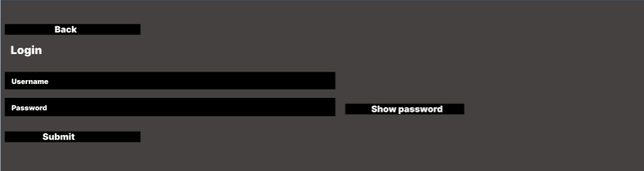
WIREFRAME

Slide 11


Challenges I’VE FACED
Coding challenges
Novice at JavaScript, HTML and CSS
Slowed down progress to implement features
Time management with other projects
Initial creation of validation of input
Implementation of timer
Creation of pseudo-random words as expected input
Creating endOfLine function
Use of query selector, use of nth child and spans
Researching and implementing Json without node.js
Use of local web server

Slide 12

Reflection
Overall, am proud of this project creating a rather well-rounded result, having learnt a lot about development lifecycle of a project and the coding languages I’ve used.
However, there are a few things I would like to improve looking back on the project, given further time:
I would have liked to used node.js for proper JSON handling
I would have liked to include a button to change between light/dark mode instead of depending on system settings
I would have liked to include more difficulty options/timer options to choose from
I would like to be able to grab words/paragraphs from the internet instead of from a crafted list
I would like to allow users to stay logged in after refreshing page
I would have liked to include more learning practices such as encouraging touch typing, the fastest typing method, by using an onscreen keyboard or/and a guide
Given now I have more experience, I would like to do a more advanced project.

Slide 13
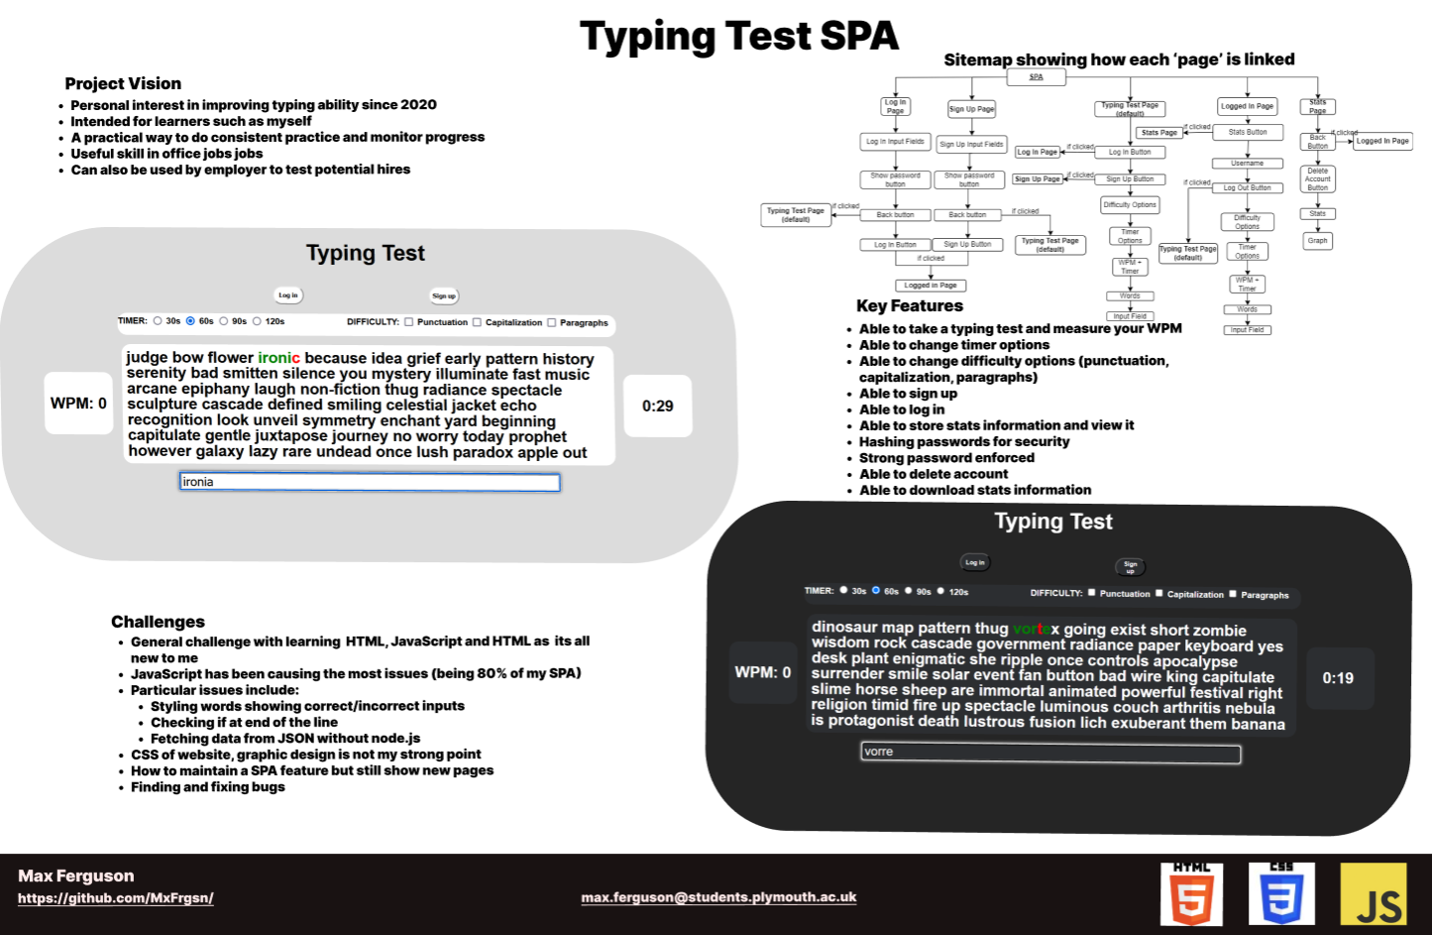
Poster

